Slide 1



WELCOME!
Celebrating Over Twenty Years of Excellence in Development of Biomedical Research in Puerto Rico!
NIH/NIGMS 5P21GM103475

Slide 2
Developmental Research Projects Program (DRPP)
Informational Workshop
2025-2026 Grant Cycle
Su Dharmawardhane, Ph.D.
INBRE DRPP Director
758-2525X1623
Su.d@upr.edu
inbre_proposals@hpcf.upr.edu
NIH/NIGMS P21GM103475-21

Slide 3

Background
INBRE has been active in Puerto Rico since 2001.
Currently in Year 4 of a new cycle (July 15, 2021 to June 30, 2026.

Slide 4
Program Officer-NIH
External Advisory
Committee
Principal Investigator
Program Coordinator
Evaluation & Tracking
Administrative Core
Program Administrator
Administrative Assistant
Project Coordinator
Steering Committee
Mentoring Coordinator
Bioinformatics
Core Directors
Centralized
Research and
Instrumentation
Core Director
Developmental Research Projects Program
Core Director
Coordinator
Science,
Technology, and
Competency
Enhancement
Core Director
Access to Biomedical Electronic Scientific
Information
Data Visualization &
Data Analysis
Community Based Research
DNA Sequencing
& Genotyping
Facility Coordinator
Genetics
Facility Coordinator
Proteomics
Facility Coordinator
Metabolomics
Facility Coordinator
ChemTox
Facility Coordinator
Protein Dynamics
Facility Coordinator

Slide 5
External Advisory Committee
James R. Brown M.Sc., Ph.D.
Senior Director
Computational Biology and Integrated
Data Science Kaleido Biosciences
Lexington MA 02421 USA
Reinhard Laubenbacher, Ph.D.
Dean’s Professor of Systems Medicine
Director, Laboratory for Systems Medicine
Division of Pulmonary, Critical Care,
and Sleep Medicine
Department of Medicine
University of Florida
Sanjay V. Malhotra, Ph.D., FRSC
Professor & Endowed Chair in Cancer Research
Director, Center for Experimental Therapeutics
Oregon Health & Science University
Stephen J. Cutler, Ph.D.
Dean and Professor
College of Pharmacy
University of South Carolina
Veronica Martinez, Ph.D.
Associate Prof. in Residence
Pathology & Laboratory Medicine
University of California at Davis

Slide 6

PR-INBRE EAC Members
Drs. James Brown, Veronica Martinez, Reinhard Laubenbacher, Orestes Quesada (VP for Res), José Rodríguez-Medina (PI), Sanjay Malhotra, Stephen Cutler

Slide 7
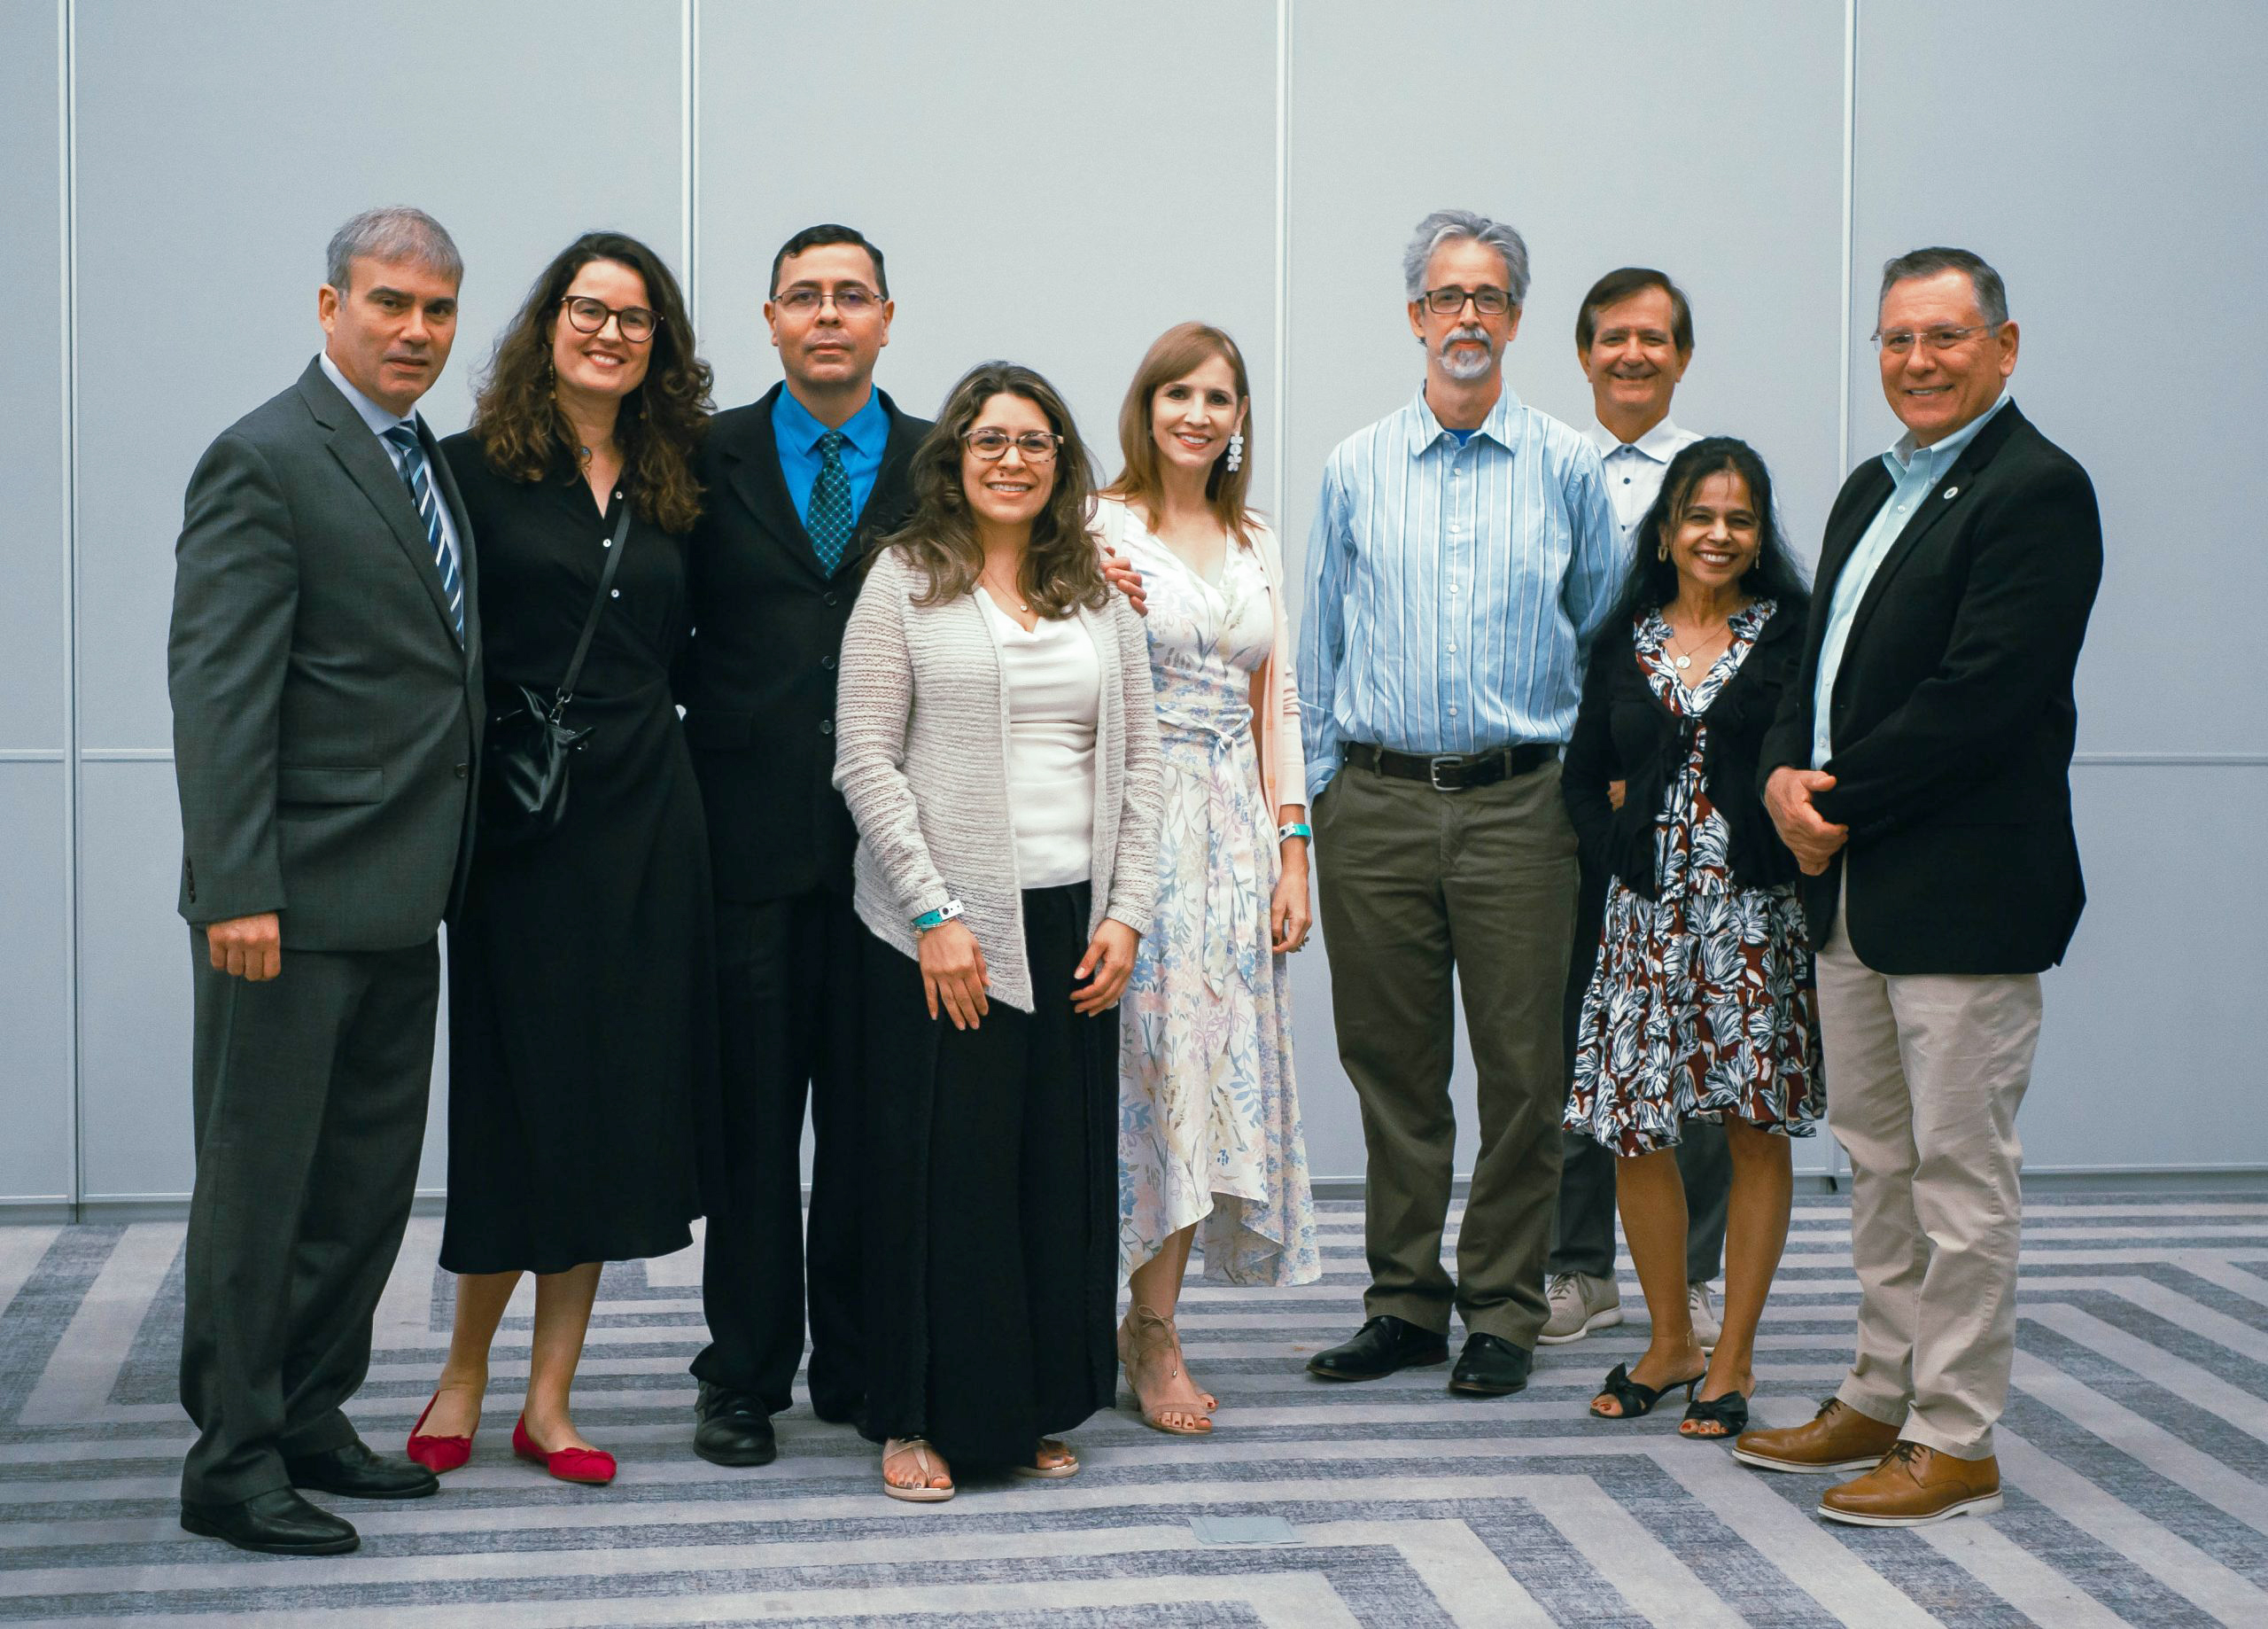
PR-INBRE Cores
PI: José Rodríguez-Medina
BIRC: Humberto Ortiz, Filipa Godoy, Luis Vazquez; CRI: Beatriz Zayas
STCE: José Rodríguez-Orengo, Loyda Mendez; DRPP: Suranganie Dharmawardhane

Slide 8

NETWORK IMPACT

Slide 9
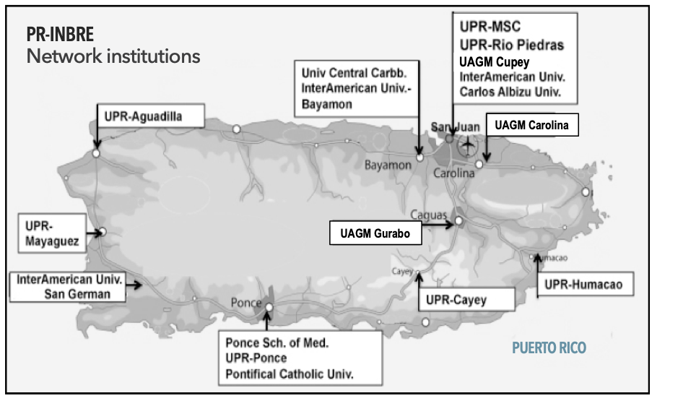

Slide 10

GOAL 1
Build on the established multi-disciplinary research network with a scientific focus to strengthen the lead and partner institutions' biomedical research expertise and infrastructure
PR-INBRE

Slide 11
GOAL 2
Enhance the research capacity of network institutions so they can participate more fully in the competition for NIH awards
  Collaborative partnerships
  development of areas of
  potential research
  research support for faculty development
  access to research resources
PR-INBRE

Slide 12
GOAL 3
Provide hands-on research experiences, mentoring, and career development activities for students and faculty at primarily undergraduate institutions, community colleges, and minority serving institutions, and serve as a pipeline to health research careers
PR-INBRE

Slide 13

Follow the PR-INBRE Website
for updates
http://inbre.hpcf.upr.edu/

Slide 14


Like us on

Slide 15
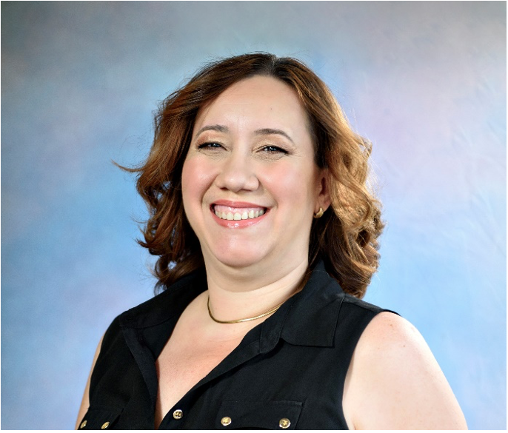
Developmental Research Projects Program
Core Team
Director: Suranganie Dharmawardhane, Ph.D.
Su.d@upr.edu
Coordinator: Jessyka Rosado
Jessyka.rosado@upr.edu

Slide 16
Core Specific Aims
Specific Aim 1: Implement a structured mentoring program for the DRPP investigators
Specific Aim 2: Provide research support to promising investigators
Specific Aim 3: Enhance the research infrastructure of the PUIs and reinforce access to core facilities

Slide 17
OUTLINE
PR-INBRE Developmental Research Projects Program (DRPP) Funding process overview
PHS 398 Forms- what we expect
Composition of an Abstract/Summary
Specific Aims Page
Approach section
Additional attachments

Slide 18

Core Goals and Aims
Provide mentoring and financial support to the developmental project investigators in four scientific cluster areas:
1. Neuroscience
2. Molecular Medicine/
Genomics
3. Drug Discovery
and Development
4. Bioinformatics
Support meritorious research to give release time and enable generation of data to submit manuscripts and grant proposals!
Success is measured by independent awards from NIH, NSF, DoD, etc.

Slide 19
Developmental Research Projects Program (DRPP)
2P20GM103475-21
Budget: 1.5 million
Aim 1:
  Full project funding ($100,000/yr) for 2.5 years ($250,000)
Aim 2:
  Pilot projects $50,000/yr
Aim 3:
  Small instrumentation grants $25,000 each
  Feasibility grants $10,000 each

Slide 20
Aim 3A. Small instrumentation grants for PUIs.
  $25,000 each non-renewable for small instrument needs
Aim 3B. Mini grants for feasibility studies.
  ~$5-10,000 each, nonrenewable for collaborative projects- grant or manuscript submission
To use the INBRE core facilities.
Specific Aim 3: Enhance the research infrastructure of the PUIs and reinforce access to core facilities.

Slide 21






ChEMTox
Biotesting
Metabolomics
Human Genetics and Genomics
Sequencing Genomic Facility
Translational Proteomics
Dr. Beatriz
Zayas
Dr. Loyda
Melendez
Centralized
Research
Instrumentation
Dr. Nataliya
Chorna
Dr. Riccardo
Papa
Dr. Carmen
Cadilla
Microbiome
Dr. Filipa Godoy

Slide 22
Eligible for Pilot Projects
Lead Institutions:
Eligible for both Full and Pilot Projects
University of Puerto Rico (UPR) Medical Sciences Campus
10 ORIs:
7 PUIs:
UPR-Rio Piedras Campus
Ponce School of Health Sciences
UPR-Mayaguez
Univ. Central del Caribe
UPR-Aguadilla
Not Eligible for funding under DRPP
UPR-Cayey
UPR-Ponce
UPR-Humacao
UPR-Carolina
UAGM Gurabo
Pontifical Catolica Univ.
UAGM Carolina
Interamericana Bayamón
UAGM Cupey
InteramericanaSan German
InterAmerican Metropolitan
Sagrado Corazon Univ.
Carlos Albizu Univ.

Slide 23
PR-INBRE DRPP Funding Cycle 4
FOA
09/16/2024
1-page LOIs
10/16/2024
Invitations for proposals
(Full and Pilots)
10/23/2024
Complete Proposals
December 23, 2024

Slide 24
What happens to your application?
Applications due Dec 24, 2023
Inbre_proposals@hpcf.upr.edu
January 2025: First Tier Review
1 Reviewer INBRE Administrative core
1 Reviewer in PR
1-2 Reviewers outside of PR
April 2025: Internal Review Committee:
Second Tier Review
Impact Factor ≤35 (pilot) and ≤30 (Full)
Technical merit, Scientific excellence, and Programmatic relevance.
May 2025: Third Tier Review
External Advisory Committee
Final Approval from NIH Program Office for Compliance
June 2025

Slide 25
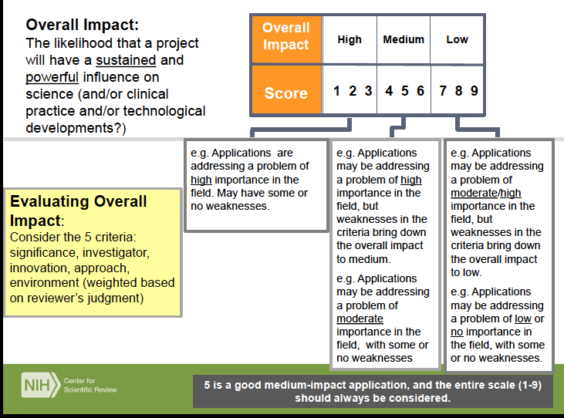

Slide 26


Each Reviewer will assign a score using the following criteria:
Significance
Investigators
Innovation
Approach
Non-Scored Criteria: Environment, Protection of human subjects and animal research

Slide 27
Funding Opportunity Announcement (FOA)
Please, use PHS398 forms (SF424 forms will not be accepted)!
A developmental mentoring/collaboration plan is mandatory:
Full Proposals Pilot Proposals
Application page limit | 12 | 6
Mentoring/Collaboration Plan | Should be included within the 12-page limit | Should be included within the 6-page limit
Required Support Letters | Letter or e-mail from the mentor and a letter of support from Department chair detailing full time employment as faculty with approval of at least 50% release time. | Letter or e-mail from the collaborator and a letter of support from Department chair detailing full time employment as faculty with approval of at least 25% release time.
IRB and IACUC Applications | Evidence required if applicable | Evidence required if applicable
Number of anticipated awards | 2 | 6
Total Period Funding | $100,000 | $50,000
Maximum Project period | 1.0 yr | 1.0 yr
If the project involves OMICS or statistics- please consult with PRINBRE Bioinformatics core! http://inbre.hpcf.upr.edu/bioinformatics-resource-core/

Slide 28
Developmental Plan
Mandatory Training/Developmental Plan:
Include a detailed training and Individual Development Plan (IDP). Identify weaknesses and indicate how collaborators and mentors can fill these gaps. Discuss how mentors and collaborators will specifically help the proposed research and your IDP.
Indicate plans for training, conferences, publications, and grant applications.
Explain how you would use this mechanism to leverage independent federal funding.
The INBRE Leadership and the EAC can help you!

Slide 29
INBRE EAC Expertise
EAC member Reinharad Laubenbenbacher, Ph.D., Professor, Jackson Laboratory Cancer Center
    https://www.jax.org/research-and-faculty/faculty/reinhard-laubenbacher
Bioinformatics
EAC Member Dr. James Brown, Director, Computational Biology & GlaxoSmithKline Senior Fellow
  https://www.linkedin.com/in/james-brown-1b652a6/
Drug development, Bioinformatics, and computational biology
EAC Member Dr. Sanjay Malhotra, Professor, Ohio Health Sciences University
    https://www.ohsu.edu/school-of-medicine/malhotra-lab/people
Experimental therapeutics for cancer
EAC Member Dr. Stephen Cutler, Dean, College of Pharmacy, University of South Carolina
    https://www.sc.edu/study/colleges_schools/pharmacy/faculty-staff/cutler_stephen.php
    Natural products chemistry
  EAC Member Dr. Verónica Martinez-Cedeño, Professor, University of California, Davis.
  https://biology.ucdavis.edu/people/veronica-martinez-cerdeno
  Expertise in neuroscience, neurodegenerative diseases, autism

Slide 30
INBRE Cores http://inbre.hpcf.upr.edu/
Bioinformatics Resources Core (BiRC): Director, Dr. Humberto Ortiz: For assistance with bioinformatics and statistical design visit http://inbre.hpcf.upr.edu/bioinformatics-resource-core/
Centralized Research Instrumentation (CRI): (http://inbre.hpcf.upr.edu/centralized-research-instrumentation/) Director: Beatriz Zayaz, Ph.D.
Genomics: Dra. Carmen Cadilla; Sequencing and Genotyping: Dr. Ricardo Pappas; Proteomics, Dra. Loyda Melendez; Metabolomics, Dra. Natalya Chorna, and Chem Tox, Dra. Beatriz Zayas
Small Grants Program gives upto $10,000 to use INBRE core services!
Science and Technology Competency Enhancement Core (STCE): Director, Dr. José Rodríguez-Orengo. Student stipends and student and faculty summer internships. http://inbre.hpcf.upr.edu/stce/
Developmental Research Projects Program (DRPP): Drs. Su Dharmawardhane has expertise in cancer biology, breast and pancreatic cancer, and cell and mouse models for testing experimental therapeutics.
Consult with Ms. Jessyka Rosado for all your budgeting needs!

Slide 31
http://grants.nih.gov/grants/funding/phs398/phs398.html
Grant Application PHS 398 (Revised 03/2020)
Form Page 1: Face Page
Form Page 2: Summary, Relevance, Project/Performance Sites, Senior/Key Personnel (Biosketches 5 page), Other Significant Contributors, and Human Embryonic Stem Cells
Form Page 3: Research Grant Table of Contents
Form Page 4: Detailed Budget for Initial Budget Period
Form Page 5: Budget for Entire Proposed Project Period
(Modular Budget Form, with budget justification)
Resources Format Page
Checklist Form
For Human subjects research:
Planned Enrollment Report
Cumulative Inclusion Enrollment Report
Please, do not scan your forms! Fill in Microsoft word, then convert to pdf!

Slide 32
Form Page 1
Title of Project: 81 characters
Must be the same as your LOI, approved IACUC or human IRB protocol. The title should capture the essence of project objectives
Human subjects and animal research: Yes or NO
If Yes: add correct Federal-wide assurance number for human subjects research
If No to 4- do not fill out 4a-4d
Add animal welfare assurance No. only if you say yes to animal research
Dates of Proposal:
Initial: 07/15/25-06/30/26
Pilot=$50,000
Total:
Pilot: 07/15/25-06/30/26 =$50,000+50,000=$100,000
Please include signature

Slide 33
Form Page 2
Project Summary:
30 lines
Hypothesis-Driven Research
Concise presentation of the project.
Include the project’s broad, long-term objectives and specific aims
Include a description of the research design and methods for achieving the stated goals
Write in plain language, so even a non-scientist can understand the importance of the project
What are you going to do, why you are doing it, what do you hope to find?
Project Relevance:
Maximum 3 sentences on the biomedical relevance of the project.
Please, fill this space.
Do NOT give a separate attachment!
Why should NIH fund it?

Slide 34
Code Words in Project Summary
LONG TERM GOAL/S
CRITICAL NEED
GAP IN KNOWLEDGE
OBJECTIVE
RATIONALE
CENTRAL HYPOTHESIS SPECIFIC AIMS
IMPACT

Slide 35

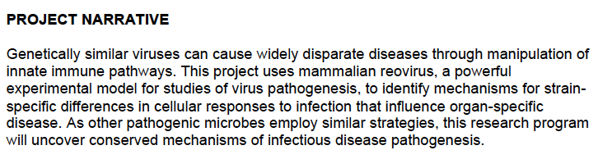
RELEVANCE:
3 sentences on health relevance

Slide 36
Table of Contents
Please, note that the Bibliography (References) are included after the Research Strategy and is not constrained by page limits.

Slide 37
Who is doing the study?
Chose Wisely…..
Include NIH Biosketches and letters
Key personnel: Ph.D./MD
PI
Mentor
Collaborator
Post Doc

Slide 38
Biographical Sketch
OMB No. 0925-0001 and 0925-0002 (Approved Through 01/31/2026)
BIOGRAPHICAL SKETCH INSTRUCTIONS
https://grants.nih.gov/grants/forms/biosketch.htm
NOTE: The Biographical Sketch may not exceed five pages.
Fill in the name of the senior/key person or other significant contributor in the “Name” field of the Biosketch Format Page.
eRA Commons User Name:
If the individual is registered in the eRA Commons, fill in the eRA Commons User Name in the “eRA Commons User Name” field of the Biosketch Format Page.
Position Title:
Fill in the position title of the senior/key person or other significant contributor in the "Position Title" field of the Biosketch Format Page.

Slide 40
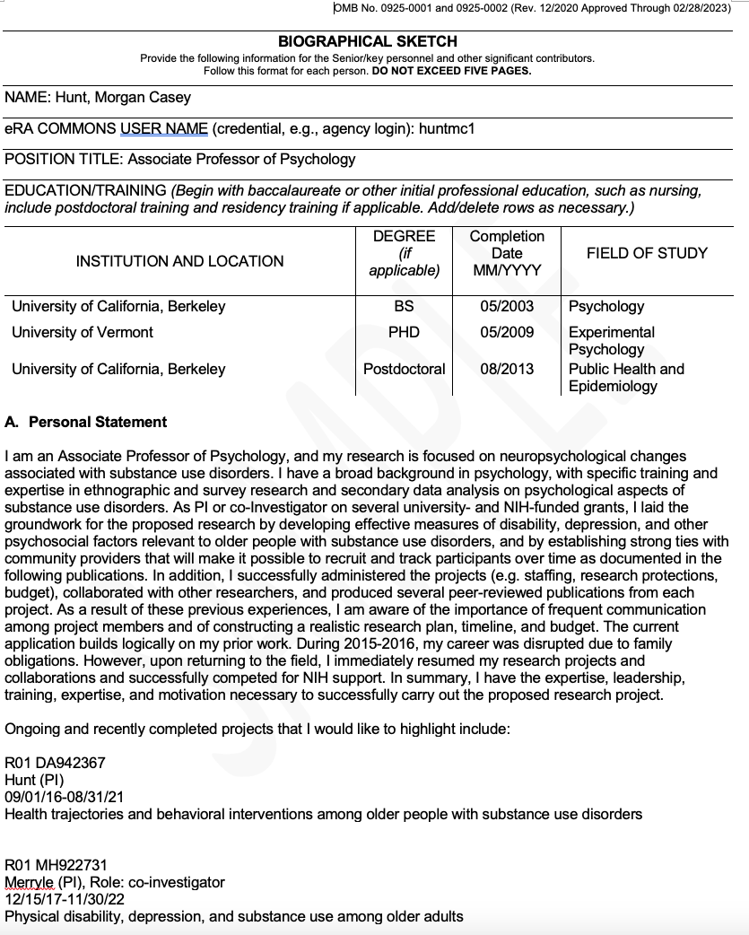
A. Personal Statement
Briefly describe why you are well-suited for your role(s) in this project. Relevant factors: aspects of your training; your previous experimental work on this specific topic or related topics; your technical expertise; your collaborators or scientific environment; and/or your past performance in this or related fields, including ongoing and completed research projects from the past three years that you want to draw attention to (previously captured under Section D. Research Support).

Slide 41
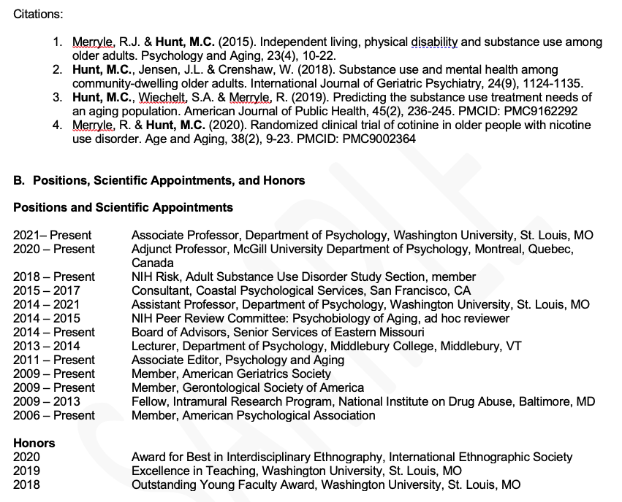
You may cite up to four publications or research products that highlight your experience and qualifications for this project: audio or video products;
conference proceedings such as meeting abstracts, posters, or other presentations;
Patents;
data and research materials;
Databases;
educational aids or curricula; instruments or equipment;
models; protocols;
and software or netware.
Use of hyperlinks and URLs to cite these items is not allowed.
You are allowed to cite interim research products:
e.g. preprints of accepted articles, pre-registered protocols
B. List in reverse chronological order all current positions and scientific appointments both domestic and foreign, including affiliations with foreign entities or governments. This includes titled academic, professional, or institutional appointments whether or not remuneration is received, and whether full-time, part-time, or voluntary (including adjunct, visiting, or honorary).
List any relevant academic and professional achievements and honors. Students, postdocs, and junior faculty should include scholarships, traineeships, fellowships, and development awards.
Clinicians should include information on any clinical licensures and specialty board certifications that they have achieved.

Slide 42
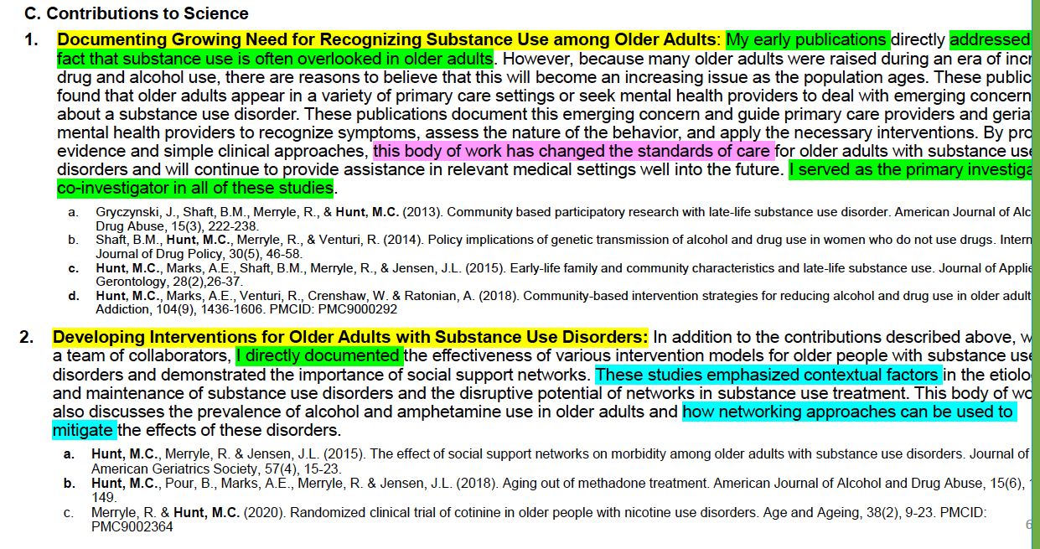
Contributions to Science
Format: Briefly describe up to five of your most significant contributions to science. The description of each contribution should be no longer than ½ page, including citations. For each contribution, cite up to 4 publications or products.

Slide 43
Contribution to Science
Content: Figures, tables, or graphics are not allowed.
For each contribution, indicate the following:
  the historical background that frames the scientific problem;
  the central finding(s);
  the influence of the finding(s) on the progress of science or the application of those finding(s) to health or technology;
  your specific role in the described work.
For each contribution, you may cite up to four publications or research products that are relevant to the contribution. If you are not the author of the product, indicate what your role or contribution was. Note that while you may mention manuscripts that have not yet been accepted for publication as part of your contribution, you may cite only published papers to support each contribution.
You may provide a URL to a full list of your published work. This URL must be to a Federal Government website (a .gov suffix). NIH recommends using My Bibliography. Providing a URL to a list of published work is not required.
Complete List of Published Work in MyBibliography: https://www.ncbi.nlm.nih.gov/myncbi/1lCifFFV4VYQZE/bibliography/public/
Additional Information: Research Support changed to Scholastic Performance – postdoc and predoc applicants

Slide 44
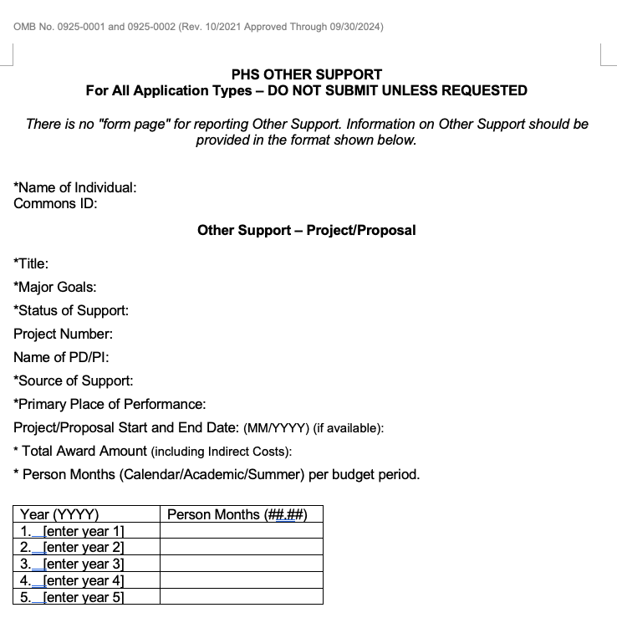
Other Support
Other support includes all resources made available to researchers or senior key personnel in support of and/or related to all of their research endeavors, regardless of whether or not they have monetary value and regardless of whether they are based at the institution the researcher identifies for the current grant.
This includes: resources and/or financial support from all foreign and domestic entities that are available to the researcher. This includes, but is not limited to, financial support for laboratory personnel, and provision of high-value materials that are not freely available (e.g., biologics, chemicals, model systems, technology, etc.). Institutional resources, such as core facilities or shared equipment that are made broadly available, should not be included in Other Support, but rather listed under Facilities and Other Resources.

Slide 45
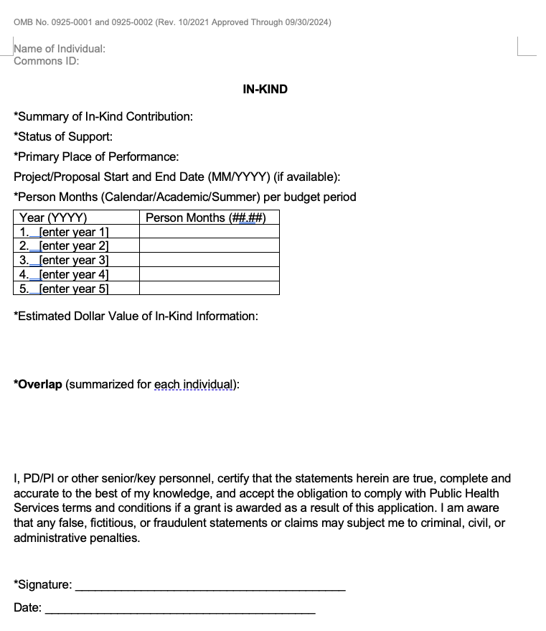
If in-kind contributions are intended for use on the project being proposed to NIH in this application, the information must be included as part of the Facilities and Other Resources or Equipment section of the application and need not be replicated on this form.
In-kind contributions not intended for use on the project/proposal being proposed in this application must be reported below. If the time commitment or dollar value is not readily ascertainable, reasonable estimates should be provided.

Slide 46
Scored Review Criteria (1-9) INVESTIGATORS
Are the PD(s)/PI(s), collaborators, and other researchers properly trained and well suited to the project?
Are the collaborators essential for the successful completion of the proposed aims?
If Early-Stage Investigators (≤10 yrs from Ph.D.) or New (No R01) Investigators, or in the early stages of independent careers, do they have appropriate experience and training?
Do early/new investigators have a tenure track or equivalent position with a firm institutional commitment on space, salary, startup funds etc.
If established, have they demonstrated an ongoing record of accomplishments that have advanced their field(s)?
Does the mentor have the adequate expertise and commitment to mentor the PI?
Is the Training Plan well developed?

Slide 47
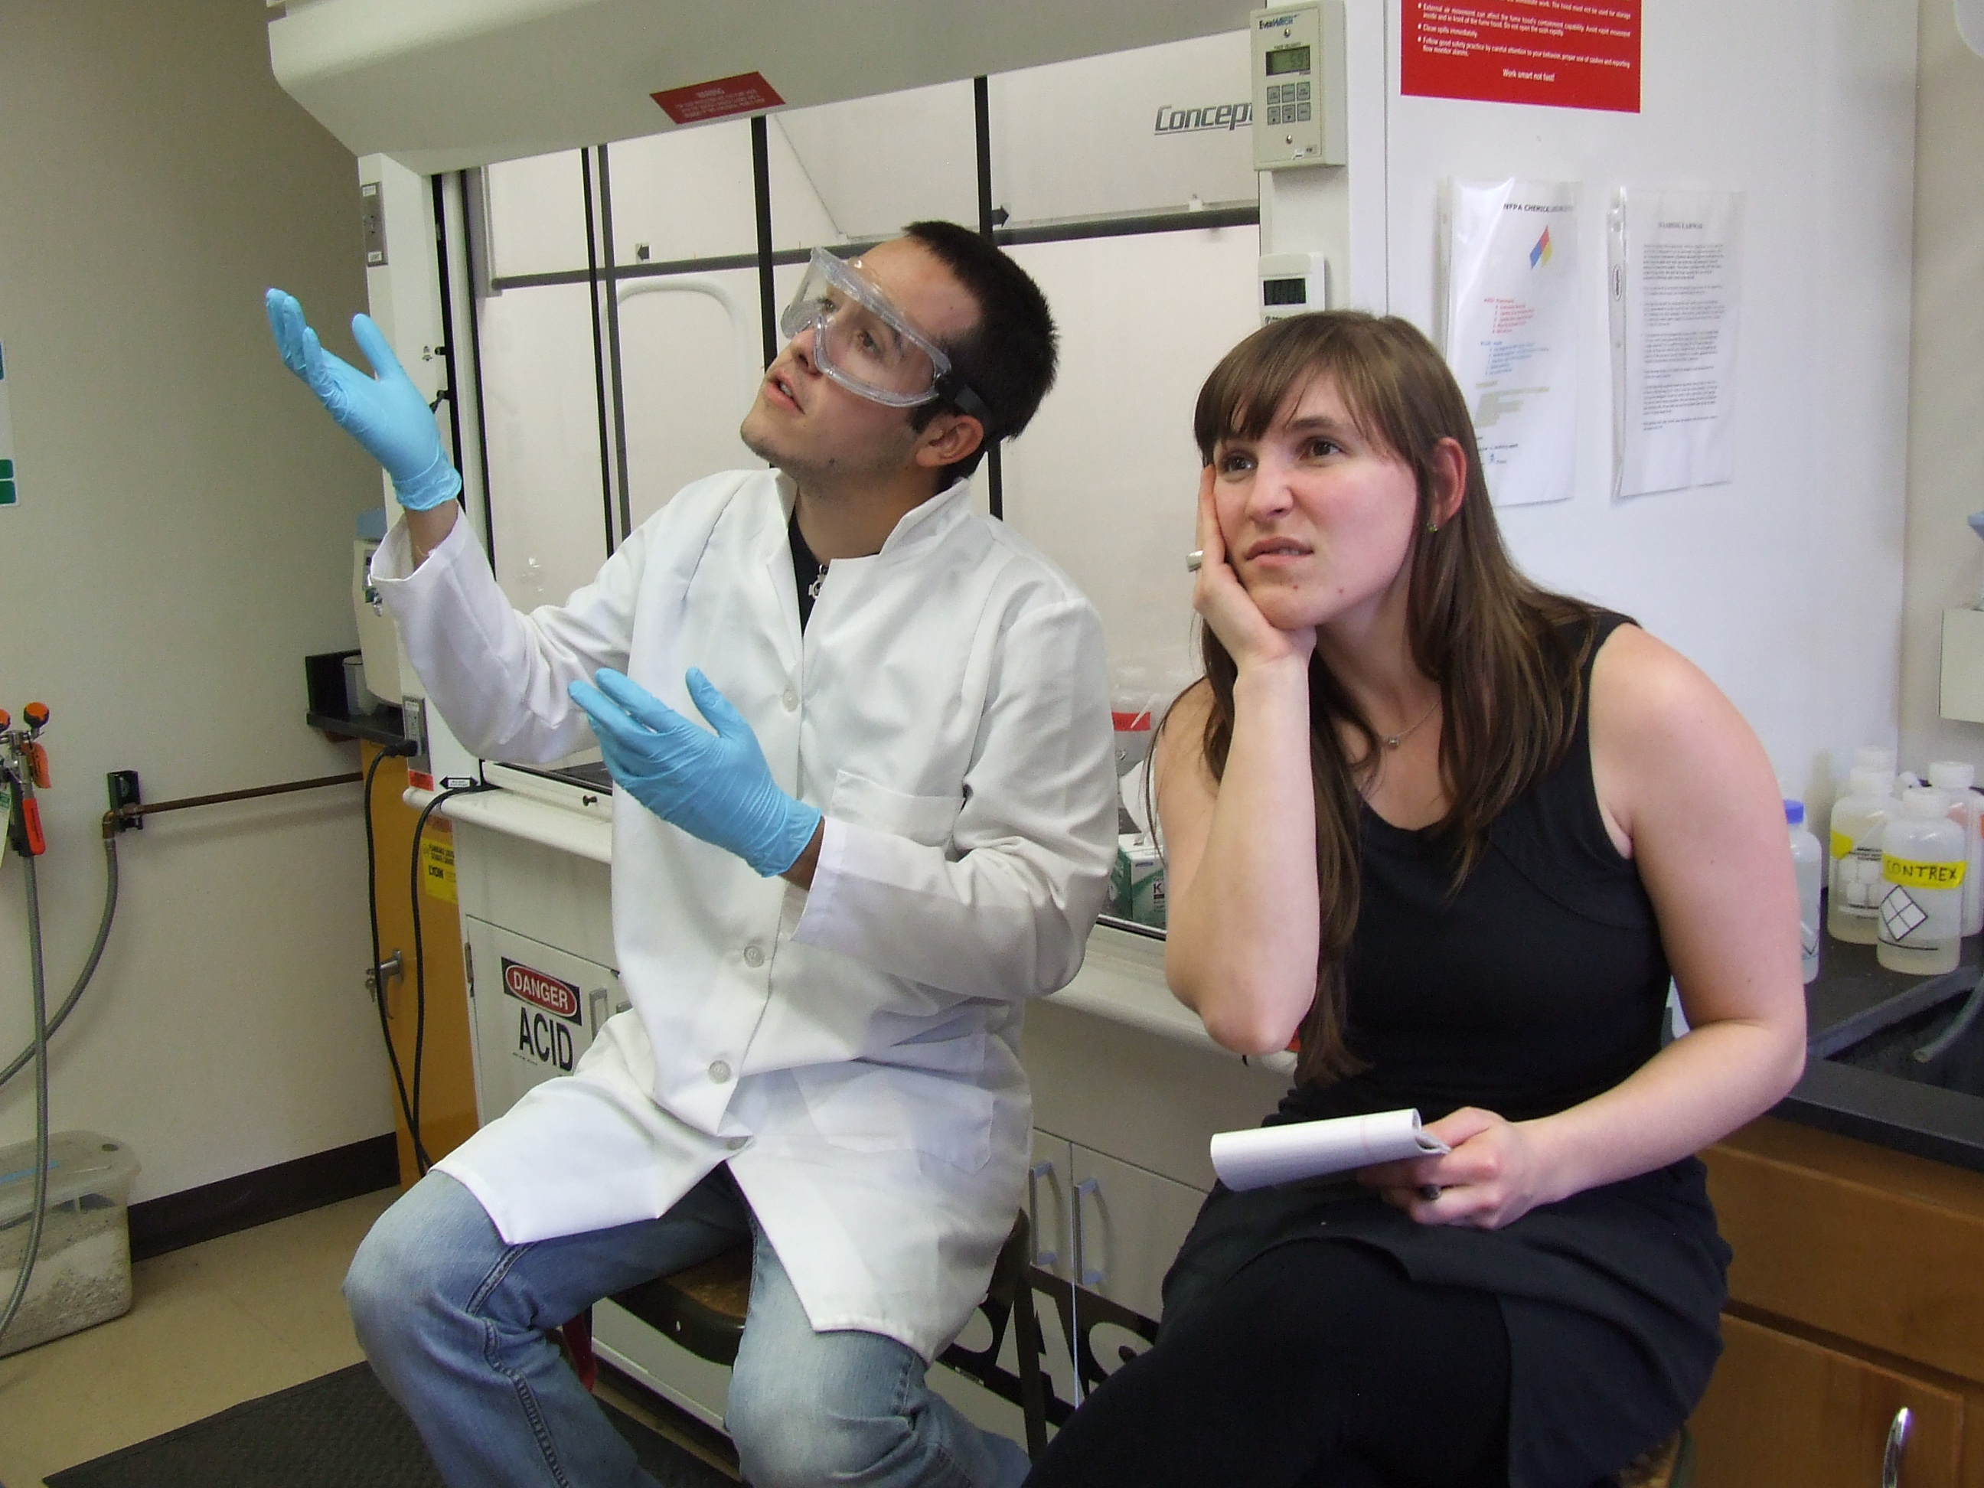
Common Problems with reviewers concerning the investigators
No demonstration of expertise or publications in the approach section.
Low productivity, few recent or few primary author papers.
Needed collaborators not recruited; letters from collaborators missing.
The collaborator does not complement the research proposed.
Mentors:
Does the mentor have publications and demonstrated expertise in the field?
Is the mentor committed to the professional development of the applicant?

Slide 48
Mentor Expectations
Assist with the outline of an individual development plan (IDP) and ensure that the investigator adheres to the guidelines of the IDP and the INBRE expectations.
Provide guidance to Developmental project investigators in the logical flow of experiment and hypothesis testing.
Advise Developmental project investigators on specific deadlines for experimental protocols.
Advise Developmental project investigators in developing strategies and deadlines for publications.
Advise Developmental project investigators in the development of specific aims for grant proposals and set specific deadlines for each section of a grant proposal.
Advise Developmental project investigators with summaries of reviewer critiques from unfunded/unscored applications on strategies for resubmission. Assist with generating the necessary preliminary data to improve resubmissions.
Serve as an initial reviewer of proposals planned for submission.

Slide 49
Mentor Expectations
Assist Developmental project investigators in the evaluation of candidate technical staff and research fellows.
Provide guidance on mentoring of the Developmental project investigator’s fellows and students.
Act as an advocate for the Developmental project investigators with administration and ensure they have “protected time” for research and career development.
Train Developmental project investigators on the preparation of presentations for national meetings.
Facilitate access to successful senior investigators through introductions.
Assist with evaluations from the external evaluator team (EET) and external advisory committee.
Mentor participation will also be evaluated by the EET, the RC, PC, and PI from the biannual progress reports and questionnaires to the Developmental project investigators.
Full proposal mentors are required to meet the DRPP director and the grantee for progress reports twice a year!

Slide 50
Contents of a Research Plan
Page:32, PHS398 instructions
1. Introduction to Application (Resubmission or Revision Applications only)
2. Specific Aims
3. Research Strategy (Significance, Innovation, and Approach)
4. Bibliography and References Cited/Progress Report Publication List
5. Vertebrate Animals
6. Select Agent Research
7. Multiple PD/PI Leadership Plan
8. Consortium/Contractual Arrangements
9. Letters of Support (e.g., Consultants)
10. Resource Sharing Plan(s)
11. Authentication of Key Biological and/or Chemical Resources
12. PHS Human Subjects and Clinical Trials Information

Slide 51
SPECIFIC AIMS
One Page (not included in 6 or 12 page limit)
The single most important section in the grant
  It’s the master plan for the rest of the proposal
  You engage or lose the Reviewer on this page
It’s the most difficult section to write
  The logic of each aim must be compelling
  The answers must be important to the field
Write Aims that you are excited about!
  - Think about research plan before you start writing

Slide 52
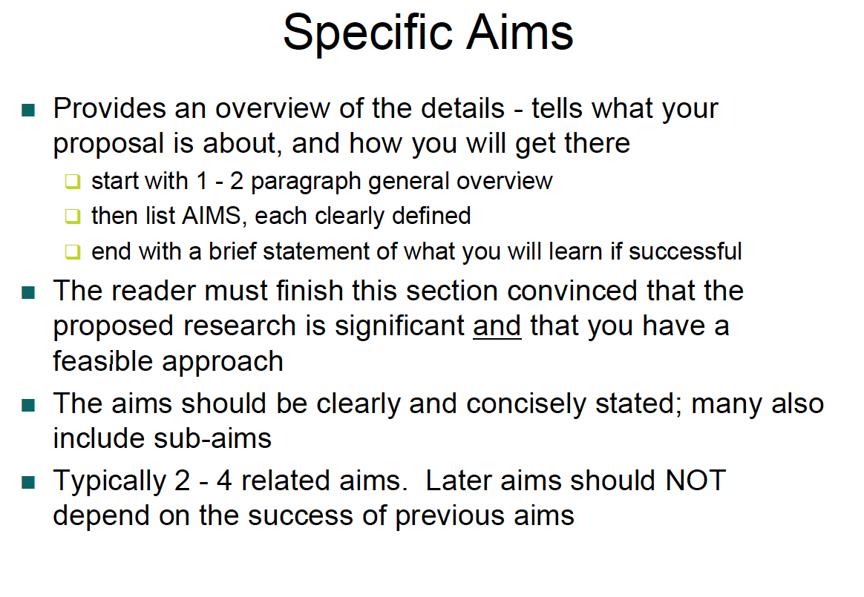

Slide 53
Specific Aims
Whenever possible – test a hypothesis in the specific aim title
  You want the Reviewer to know that your work is hypothesis driven
  Don’t make the Reviewer work to figure out what the hypothesis is
The goal of the aim should be to understand mechanism – even if the experiments are largely descriptive
1-2 Specific Aims for a 2-year grant – each aim is a manuscript, or is a significant part of a publication
The Specific Aims should be detailed but far reaching – the Aims should not be a list of experiments

Slide 54
Specific Aims: Don’ts
Write your Aims early – some may fall apart as you design a plan to test them or discuss them with colleagues.
Try to limit this section to one page – it’s a roadmap to the rest of the proposal and it must include the logic behind your aims.
Don’t assume your Reviewer is an expert in your particular area – so write Aims for a non-expert.
Used to be you couldn’t propose OMICs experiments: we love OMICS!
Don’t state a hypothesis that you cannot actually test with the experiments you are proposing.
Avoid using phrases like: To correlate… To describe… To develop; these help get your grant pegged as “too descriptive”.
Avoid wishy-washy, passive tense, or flowery language – instead write your aims in active form with strong meaningful verbs.
proposal

Slide 55
APPROACH: 6 Pages pilot proposals, 12 pages Full proposals
Significance and Innovation
0.5-1 pages SIGNIFICANCE
Explain the importance of the problem or critical barrier to progress that the proposed project addresses.
Describe the scientific premise for the proposed project, including consideration of the strengths and weaknesses of published research or preliminary data crucial to the support of your application.
Explain how the proposed project will improve scientific knowledge, technical capability, and/or clinical practice in one or more broad fields.
Should lead the reader to each question or hypothesis that you’re testing in each aim
State this explicitly
This section must explain why the Study Section should fund your proposal rather than the next one
What is the “value added” to your field if you’re able to do the work?

Slide 56
Scored Review Criteria 1-9: Significance
Does the project address an important health problem or a critical barrier to progress in the field?
If the aims of the project are achieved, how will scientific knowledge, technical capability, and/or clinical practice be improved?
How will successful completion of the aims change the concepts, methods, technologies, treatments, services, or preventative interventions that drive this field?
Common Problems with Significance and Innovation
  Not significant or exciting or new research
  Lack of compelling rationale for experiments
  Incremental or low impact research
  Weak or little biological, biomedical, or behavioral relevance

Slide 57

Scored Review Criteria: 1-9
INNOVATION (PHS 398: page 34)
Explain how the application challenges and seeks to shift current research or clinical practice paradigms.
• Describe any novel theoretical concepts, approaches or methodologies, instrumentation or intervention(s) to be developed or used, and any advantage over existing methodologies, instrumentation, or intervention(s).
• Explain any refinements, improvements, or new applications of theoretical concepts, approaches or methodologies, instrumentation, or interventions.
Innovation:
Does the application challenge and seek to shift current research or clinical practice paradigms by utilizing novel theoretical concepts, approaches or methodologies, instrumentation, or interventions?
Are the concepts, approaches or methodologies, instrumentation, or interventions novel to one field of research or novel in a broad sense?
Is a refinement, improvement, or new application of theoretical concepts, approaches or methodologies, instrumentation, or interventions proposed?

Slide 58
Criteria for scoring the approach section
Four areas deemed important for enhancing rigor and transparency:
Scientific premise of the proposed research (Significance)
Scientific rigor: Rigorous experimental design for robust and unbiased results (Research Strategy)
Consideration of relevant biological variables (Research Strategy)
4) Authentication of biological resources and chemical resources (Attachment)

Slide 59
1. Scientific Premise/Rigor of prior research
.
*Beginning with applications due on January 25, 2019 the application instructions and review criteria will be clarified to replace the term “scientific premise” with the term "rigor of the prior research". Applicants will also be instructed to describe plans to address any weaknesses in the rigor of prior research within the Research Strategy.
In the Significance section of your Research Strategy - Describe the the strengths and weaknesses of published research or preliminary data crucial to the support of your application.
The scientific premise for an application is the research that is used to form the basis for the proposed research question(s). NIH expects applicants to describe the general strengths and weaknesses of the prior research being cited by the applicant as crucial to support the application. It is expected that this consideration of general strengths and weaknesses could include attention to the rigor of the previous experimental designs, as well as the incorporation of relevant biological variables and authentication of key resources.

Slide 60
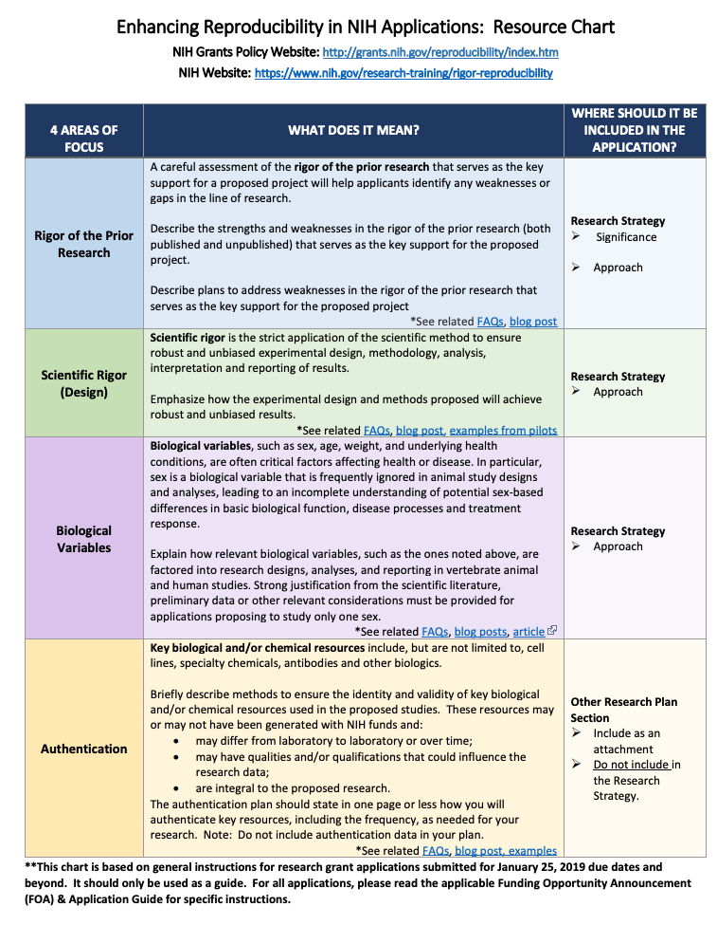

Slide 61
Preliminary Studies
(can be in Significance or in Research Strategy)
In order of Specific Aims
You don’t have to know the outcome of each experiment before the grant is submitted
You DO have to:
  Show that you can perform all of the necessary techniques and methods (Letters of Collaboration)
  You are committed to this area of research and are off and running
  New techniques are feasible, reliable and yield interpretable data
  Show that the preliminary data has scientific rigor

Slide 62

RESEARCH STRATEGY
Specific Aims are fleshed out with the actual experimental approach
  Rationale (1 paragraph) -- logic
  Experiments – how? Abbreviated Methods
    CONTROLS (positive and negative)
  Analysis and Interpretation – what will results mean?
  Pitfalls and Alternative Approaches
Your research strategy needs to answer 4 essential questions:
  What do you intend to do?
  Why is the work important?
  What has already been done?
  How are you going to do the work?

Slide 63

Scored Review Criteria: 1-9
Approach
Are the overall strategy, methodology, and analyses well reasoned and appropriate to accomplish the specific aims of the project?
Are potential problems, alternative strategies, and benchmarks for success presented?
If the project is in the early stages of development, will the strategy establish feasibility and will particularly risky aspects be managed?
How well the scientific rationale supports the project and its feasibility as demonstrated by a critical review and analysis of the literature, preliminary data, and/or logical reasoning.
How well the hypotheses or objectives, aims, experimental design, methods, and analyses are developed.
If the project involves Human Subjects Research, are the plans for 1) protection of human subjects from research risks, and 2) inclusion of minorities and members of both sexes/genders, as well as the inclusion of children, justified in terms of the scientific goals and research strategy proposed?

Slide 64
Approach: page 34: PHS398 guidelines:
l.Describe the overall strategy, methodology, and analyses to be used to accomplish the specific aims of the project.
Describe the experimental design and methods proposed and
how they will achieve robust and unbiased results. Unless
addressed separately in Item 15 (Resource Sharing Plan),
include how the data will be collected, analyzed, and
interpreted as well as any resource sharing plans as
appropriate.
II. Discuss potential problems, alternative strategies, and
benchmarks for success anticipated to achieve the aims.
If the project is in the early stages of development, describe
any strategy to establish feasibility, and address the
management of any high risk aspects of the proposed work.

Slide 65
Approach:
III. Explain how relevant biological variables, such as sex, are
factored into research designs and analyses for studies in
vertebrate animals and humans. For example, strong
justification from the scientific literature, preliminary data, or
other relevant considerations, must be provided for
applications proposing to study only one sex.
IV. If your study(s) involves human subjects, you are expected
to explain how relevant biological variables are important to the
proposed experimental design and analyses.
The sections on the Inclusion of Women and Minorities and
Inclusion of Children can be used to expand your discussion on inclusion and justify the proposed proportions of individuals (such as males and females) in the sample.
Please refer to NOT-OD-15-102 for further consideration of
NIH expectations about sex as a biological variable.

Slide 66
2. Scientific Rigor
Rigorous experimental design for robust and unbiased results: Still within the 6 or 12 page limit
o Scientific rigor is the strict application of the scientific method to ensure robust and unbiased experimental design, methodology, analysis, interpretation and reporting of results. This includes full transparency in reporting experimental details so that others may reproduce and extend the findings.
Criteria for Scientific Rigor:
Sample size, controls, repetition, statistical power: strength and weakness of experimental design, attention to rigor, the literature cited should be rigorously conducted.
Address the rigor of the published and preliminary data and in the literature you cite. Is there a strong scientific premise for the research?
How are you going to address full transparency in experimental details so others can reproduce your results.
How will you report your results?
Are your proposed experimental methods robust and unbiased?
Quality of experimental design, statistical analysis, age, weight, sex.
randomization, blinding, statistical methods, sample size estimation, appropriate replicates, scientific method, etc.

Slide 67
3. Consideration of relevant biological variables
Biological variables, such as sex, age, weight, and underlying health conditions, are often critical factors affecting health or disease. In particular, sex is a biological variable that is frequently ignored in animal study designs and analyses, leading to an incomplete understanding of potential sex-based differences in basic biological function, disease processes and treatment response.
NIH expects that sex as a biological variable will be factored into research designs, analyses, and reporting in vertebrate animal and human studies. Strong justification from the scientific literature, preliminary data or other relevant considerations must be provided for applications proposing to study only one sex. http://orwh.od.nih.gov

Slide 68
4. Authentication of key biological and/or chemical resources
Key biological and/or chemical resources include, but are not limited to, cell lines, specialty chemicals, antibodies and other biologics. Key biological and/or chemical resources:
1. may differ from laboratory to laboratory or over time
2. may have qualities and/or qualifications that could influence the data
3. are integral to the proposed research
4. are not limited to resources generated with NIH funds
Standard laboratory reagents (e.g. buffers) that are not expected to vary do not need to be included in the plan.
Briefly describe how you plan to authenticate resources. How you will ensure the identity and validity of key biological and/or chemical resources used in the proposed studies.
The quality of resources used to conduct research is critical to the ability to reproduce the results. Each investigator will have to determine which resources used in their research fit these criteria and are therefore key to the proposed research.

Slide 69

10 questions you should answer in each specific aims section of the research strategy
What is the question/aim/hypothesis?
Why is the question important and necessary to answer?
How will your research question if answered overcome hurdles or challenges and impact the field?
How are you going to answer this
significant and important question;
what approaches and why?
5. What could go wrong and what
might you do instead and/or in
addition?

Slide 70

10 questions you should answer in each specific aims section, cont.
6. How reliable, reproducible, rigorous, and interpretable might the potential data/results be?
7. How might the potential data/results be novel and significant and impact the scientific field?
8. Would anyone care about the results?
9. How would the potential data results answer your question?
10. Depending on potential outcome/results what would you do next?

Slide 71

Common problems with experimental approach
Lack of clear strong hypothesis or questions
Too ambitious too much work proposed
Unfocused or unrelated aims, unclear goals, not integrated
Limited or narrow aims
Too much unnecessary experimental details
Not enough detail on approaches being developed
Not enough preliminary data to show rationale or significance of project
Unconvincing preliminary data
Lack of appropriate controls
Not directly testing hypothesis
Correlative or descriptive data
Experiments not directed towards mechanisms
No discussion of alternative models or hypotheses
No discussion of potential pitfalls
No discussion of data interpretation or future directions

Slide 72
Other Attachments
(Page 36, PHS398 Guide)
Vertebrate Animals
If live vertebrate animals are involved in the project, address each of the following criteria:
Description of Procedures: Provide a concise description of the proposed procedures to be used that involve vertebrate animals in the work outlined in the “Research Strategy” attachment. The description must include sufficient detail to allow evaluation of the procedures. Identify the species, strains, ages, sex, and total numbers of animals by species, to be used in the proposed work. If dogs or cats are proposed, provide the source of the animals.
Justifications: Provide justification that the species are appropriate for the proposed research. Explain why the research goals cannot be accomplished using an alternative model (e.g. computational, human, invertebrate, in vitro).
3. Minimization of Pain and Distress: Describe the interventions including analgesia, anesthesia, sedation, palliative care and humane endpoints that will be used to minimize discomfort, distress, pain, and injury.
  Identify all project performance (or collaborating) sites and describe the proposed research activities with vertebrate animals that will be conducted at those sites.
  Explain when and how animals are expected to be used if plans for the use of animals have not been finalized.

Slide 73
Other Attachments
Select agents research
Select Agents are hazardous biological agents and toxins that have been identified by HHS or USDA as having the potential to pose a severe threat to public health and safety, to animal and plant health, or to animal and plant products. CDC and the Animal APHIS Select Agent Programs jointly maintain a list of these agents.
Multiple PI/PD Leadership plan
Consortium/contractual arrangements
Letters of support
Resource sharing plan
Authentication of Key Resources Plan
e.g. cell lines, specialty chemicals, antibodies, and other biologics.

Slide 74
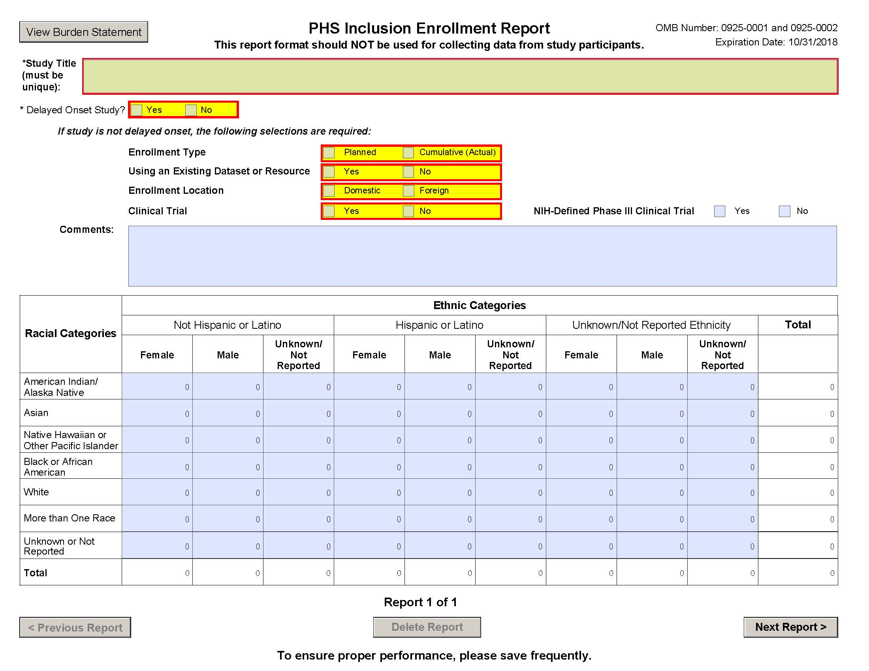
Human Subjects Research https://humansubjects.nih.gov/nih-human-subjects-policies-guidance

Slide 75
Unscored Review Criteria
Environment
Will the scientific environment in which the work will be done contribute to the probability of success?
    Do not assume! Give details in the Facilities and Resources
Are the institutional support, equipment and other physical resources available to the investigators adequate for the project proposed?
    Include letter of institutional commitment for release time and position: 50% for full projects and 25% for pilot projects
Will the project benefit from unique features of the scientific environment, subject populations, or collaborative arrangements?
    Include strong letters of commitment from mentors and collaborators!

Slide 76
FORMATTING
Text in PDF attachments must follow these minimum requirements:
Don’t scan- convert to PDF file!
Font size: must be 11 points or larger (smaller text in figures, graphs, diagrams and charts is acceptable as long as it is legible when the page is viewed at 100%).
Type density: must be no more than 15 characters per linear inch (including characters and spaces).
Line spacing: must be no more than six lines per vertical inch.
Text Color: must be black (color text in figures, graphs, diagrams, charts, tables, footnotes and headings is acceptable as long as it is legible).

Slide 77
FORMATTING
Text in PDF attachments must follow these minimum requirements:
Since some PDF converters may reduce font size, it is important to confirm that the final PDF document complies with the font requirements.
The following fonts are recommended, although other fonts (both serif and non-serif) are acceptable if they meet the above requirements.
Arial, Garamond, Georgia, Helvetica, Palatino Linotype, Times New Roman, Verdana
Legibility is of paramount importance. Applications that include PDF attachments that do not conform to the minimum requirements listed above may be withdrawn from consideration.

Slide 78

Other Important Issues
Don’t annoy the reviewer!
Page requirements: 6 (pilot) or 12 (full) pages
Font size and line spacing
SPACING OF TEXT SECTIONS
Embed figures into the text. Include a brief, clear legend.
Figure must be absolutely clear/visible to the Reviewer.
Learn how to use MS Word
Spelling and grammar – ZERO TOLERANCE for sloppy mistakes.

Slide 79
Budget
First year of the project
Key Personel & Role:
PI- CO PI- Graduate students, etc
Time & Effort:
Full project – 50% calendar year (6 months)
Pilot project – 25 % calendar year (3 months)
Include base salary
Consultants Cost is not personel:
Vendor
Subcontract
If exist a Subcontract you must include the information with the proposal
Include all expenses to be incurred this first period

Slide 80
Budget
For the entire period
Submit each line of expenses by project year
You need to include the justification of the budget in accordance with the information that is present on this page
The budget justification is the explanation of what you are going to use and its cost.
Consult with Ms. Jessyka Rosado for all your budgeting needs!

Slide 81
Please, include a checklist at the end of your application.
Your institution must have a FHA agreement with the Department of Human Health.
The indirect costs (FHA costs) have to be included in the proposal.

Slide 82

Your INBRE DRPP Award
Please, note that prior to starting your project, you are required to contact the PR-INBRE Bioinformatics Resource Core at help@hpcf.upr.edu, to receive their advice and guidance in designing and analyzing your experiments.
Please, include this award in your biosketch as a subproject from the NIGMS/INBRE award P21 GM103475-22, Project Title: “Advancing Competitive Biomedical Research in Puerto Rico”, PI: Jose Rodriguez-Medina, Ph.D.
You are the PI of a subproject under this award, and should list your name and title of sub project following this information.
Any publications resulting from the use of these funds should acknowledge the PR-INBRE Program with the following statements: "Research reported in this publication was supported by an Institutional Development Award (IDeA) from the National Institute of General Medical Sciences of the National Institutes of Health under grant number P20 GM103475-21. The content is solely the responsibility of the authors and does not necessarily represent the official views of the National Institutes of Health.”

Slide 83

DRPP Activities
Welcome to the
PRINBRE Family!
Monthly peer-review meetings, quarterly writing club.
Review of grant applications and manuscripts.
Published manuscripts need to have PMCID numbers from my bibliography (NIH Era Commons)
Annual PRINBRE retreat and EAC meeting.
Workshops, seminars, mentoring.
Annual progress reports

